Slide 1
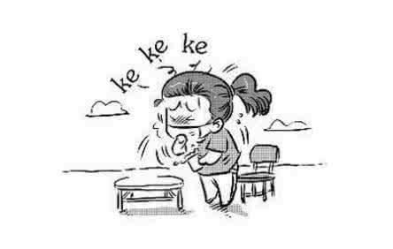




Speaker Recognition with Cough, Laugh and “Wei”
Miao Zhang & Yixiang Chen

Slide 2
Outline
Background and significance
Deep feature learning
Experiments
Results and discussions
Further work

Slide 3
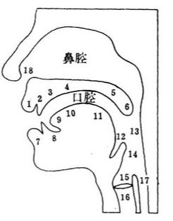
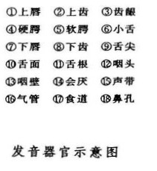
Background
Linguistic sound
Natural sound
inspiratory sound
expiratory sound
vocal cord non-related
vocal cord related
Oral cavity resonance
nasal cavity resonance
Notes:
Wei belongs to linguistic sound; Cough and laugh belong to vocal cord related sounds, and use oral cavity resonance.

Slide 4
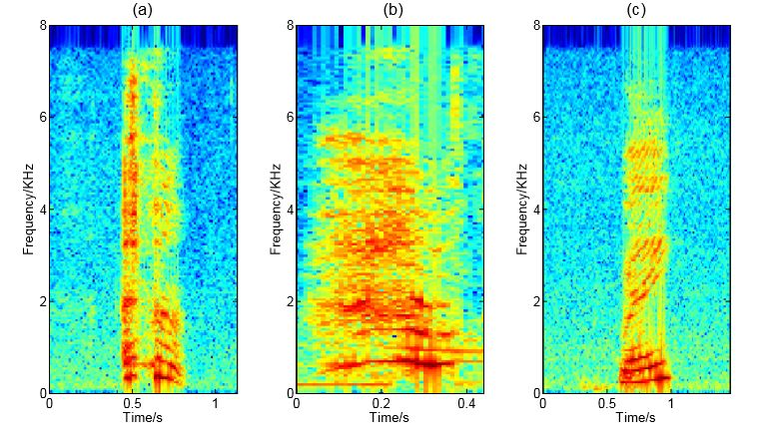
Background
Different spectra of trivial events cough, laugh and Wei
cough laugh Wei

Slide 5
Background
Almost all existing automatic speaker recognition(SRE) approaches work on long and clear linguistic content such as “Hello, Google”.
+
Very little has been done on these trivial events in SRE (short duration & significantly different pronunciation & no large-scale specific database)
With the deep feature learning structure, strong speaker features can be learnt from a very short segment (about 0.3second)
solution

Slide 6
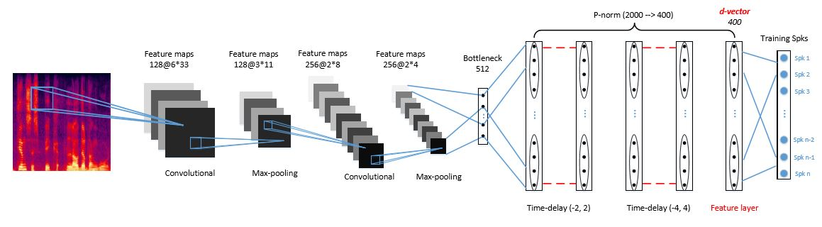
Deep feature learning
CT-DNN model can learn speaker sensitive features, which is highly
discriminative and can be used to achieve impressive performance
when the test utterances are extremely short.

Slide 7
Significance
Answer three questions:
• Does a particular trivial event involves speaker information?
• Can the speaker information, if exists in a trivial event, be extracted from the event speech?
• Can the deep feature model trained with a regular speech database be migrated to recognize trivial event segments?

Slide 8
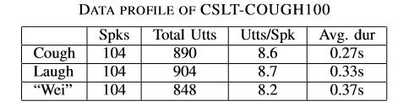
Experiment
•About database
Train with the Fisher speech database
and construct the test database with
recording.
•About data
Every speaker has three types of events
and every event contains 5—10 segments,
with the most common 7—10.

Slide 9
Experiment
•An i-vector system was constructed as the baseline system
•A d-vector system uses the CT-DNN architecture
•Use t-SNE to investigate feature discrimination with the three types of events

Slide 10
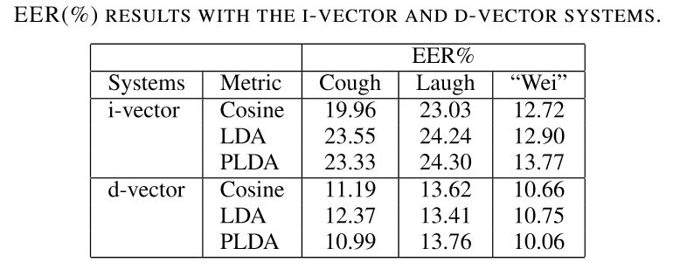
Result & Discussion
•D-vector system has general
better performance than
i-vector system.
The feature-based approach
is more powerful.

Slide 11
Result & Discussion
• For i-vector system, the
performance on “Wei” is good,
and the performance on cough
and laugh is signiﬁcantly reduced.
The i-vector model cannot extract
the information in trivial events
(cough and laugh) well

Slide 12
Result & Discussion
• For d-vector system, the best
performance is on Wei, but the
performance on cough and
laugh is not signiﬁcantly reduced.
1.Non-linguistic events still involve
rich speaker information
2.The d-vector system could deal
with them better.

Slide 13
Result & Discussion
• For d-vector system, the
performance on laugh
is slightly worse than on cough.
Laugh speech involve signiﬁcant
within-speaker variations related
to vocal tract modulation.

Slide 14
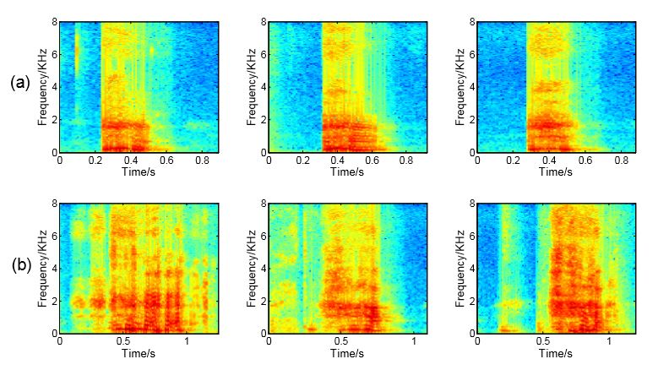

Discussion
cough
laugh

Slide 15
Result
• For both two systems, the
discriminative normalization
approaches, LDA and PLDA,
did not provide clear advantage.
LDA and PLDA models trained
with the regular speech database
are not very suitable.
Notes:
demonstrates that there are still differences between regular speech and trivial speech recognition.

Slide 16
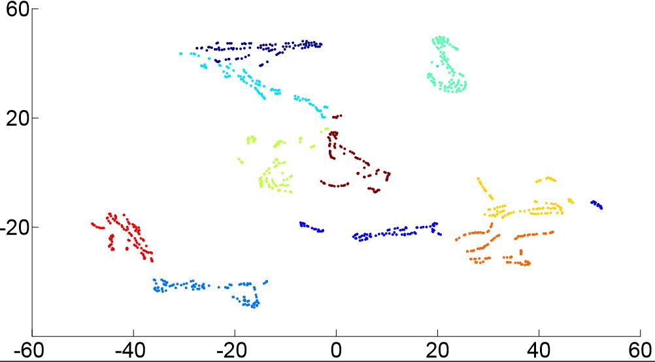
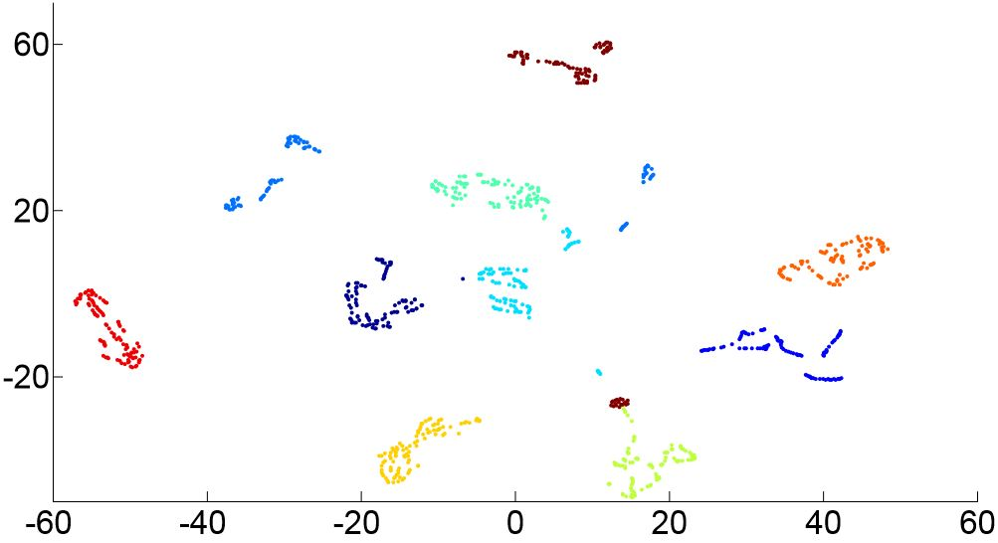
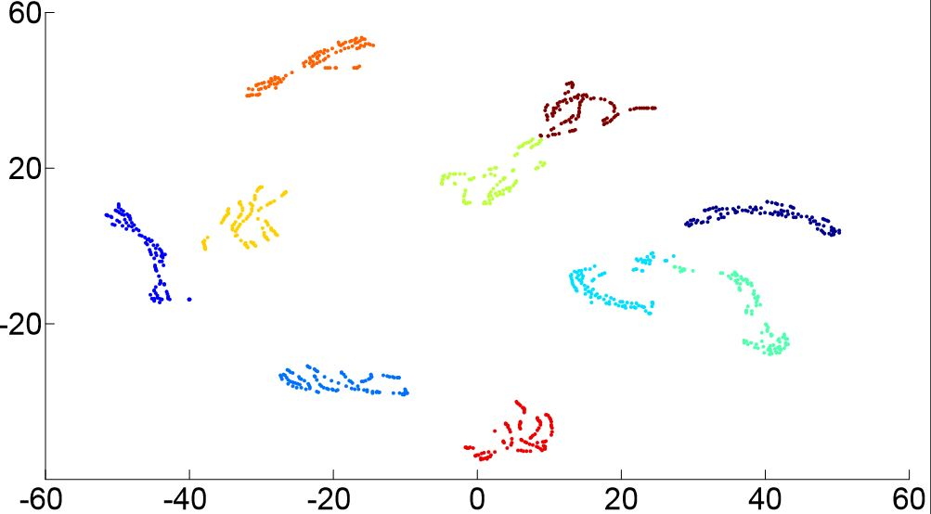
Result
•Wei
The learned features are reasonably discriminative for speakers.
•cough and laugh
There are still variations.
cough laugh Wei

Slide 17
Summary
In spite of the extremely short duration and lack of linguistic
information, the EER can be as low as 10%-14%, depending
on the type of events.
A satisfying performance!!

Slide 18
Conclusion
• Does a particular trivial event involves speaker information?
Yes.
At least for the three trivial events studied in this paper, rich speaker information is involved.
• Can the speaker information, if exists in a trivial event, be extracted from the short segment?
Yes. The deep feature approach was capable of extracting the speaker information from the short and idiocratic trivial events.
• Can the deep feature model trained with a regular speech database be migrated to recognize trivial event segments?
Yes. A DNN model trained with the Fisher database worked well on trivial event SRE.

Slide 19
Further works
How about the performance on other trivial events (every type referred in background), and which one is most discriminative?
What is the implication of the experimental results for the acoustic and linguistic research?
How the performance will be in a true scenario of speech disguise?

Slide 20
Thank you

