Slide 1
ASR-Free Pronunciation Assessment
Sitong Cheng
Zhixin Liu

Slide 2

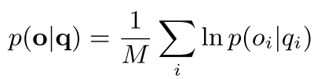

Introduction
Goodness of Pronunciation (GOP)
GOP is based on the posterior probability on the correct phone, given the speech segment of that phone
= i-th phone in the speech segment
= corresponding speech segment
= total number of phones in the speech segment
If given a phone sequence q and the corresponding speech signal o, and assume the alignment is perfect
ignored
However ……

Slide 3
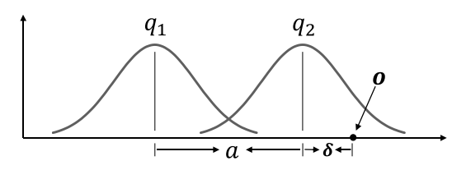



Problems
There is no guarantee that a worse pronunciation will achieve a smaller posterior!
perfect pronunciation of :
non-native speaker pronounce at a position o
If > 0, the posterior essentially increases. This means that a non-native speaker obtains a better GOP than a native speaker.

Slide 4
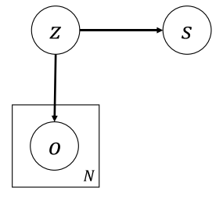
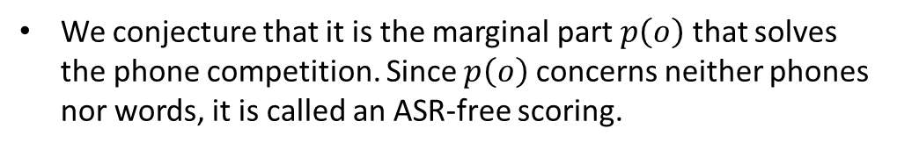

Solutions: ASR-free scoring
We conjecture that it is the marginal part $p\left(o\right)$ that solves the phone competition. Since $p\left(o\right)$ concerns neither phones nor words, it is called an ASR-free scoring.
Method
We cannot directly use $p(o)$ , since $p\left(o\right)$is quite noisy
$$p\left(o\right)→p(z) →p(s)$$

Slide 5

Three Marginal models
$$p\left(o\right)→p(z)$$
i-vector model
Normalization flow
All vectors are trained with je-1520
Discriminative NF

Slide 6

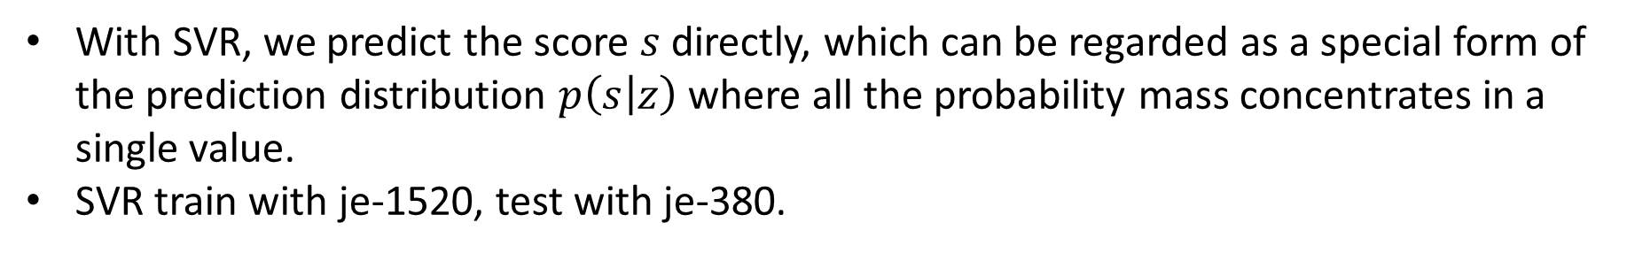
Prediction model
$$p\left(z\right)→p(s)$$
With SVR, we predict the score $s$ directly, which can be regarded as a special form of the prediction distribution $p\left(s | z\right)$where all the probability mass concentrates in a single value.
SVR train with je-1520, test with je-380.

Slide 7


Information fusion
Score fusion
γ(·) is the prediction function implemented by SVR
Feature fusion
we treat the GOP score $p\left(q | o\right)$as a feature and combine it with the latent representation $z$, and then build the SVR model.

Slide 8

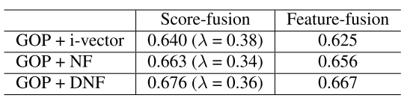

Experiments & Results
All results use PCC
Basic results
ASR-free scoring
Information fusion

Slide 9
Conclusion
Our theoretical study shows that this scoring approach offers an interesting correction for the phone-competition problem of GOP, and empirical study demonstrated that combining the GOP and this ASR-free approach can achieve better performance than the GOP baseline.

Slide 10
Thank you !

