Slide 1
2015: Step to Future
Dong Wang
2015 CSLT Speech Team Annual Banquet
2016-01-10

Slide 2
Happy new year!

Slide 3
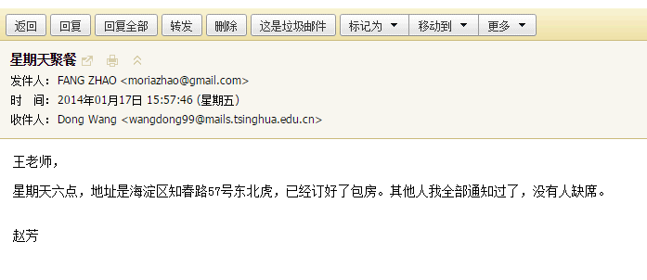
2013 Annual Banquet

Slide 4
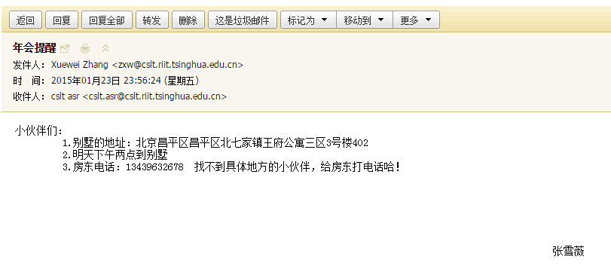
2014 Annual Banquet

Slide 5
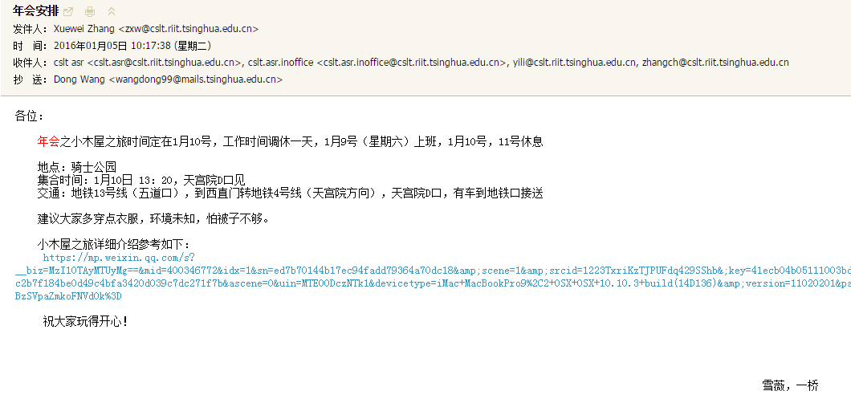
2015 Annual Banquet

Slide 6
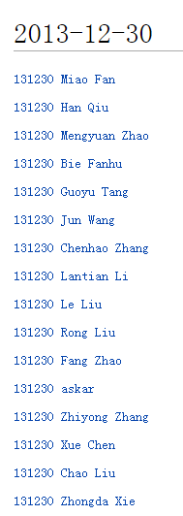
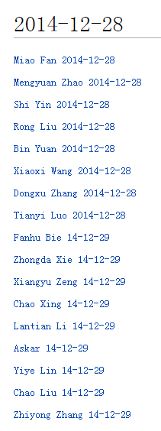
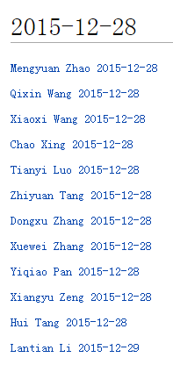

Slide 7
Finance
Three partners
Sinovoice, Huilan, Puqiang
Three projects
NSFC, Huilan, Sinovoice
Reasonable funding
670k + 200k external intern salries

Slide 8
Travel
Conference attendence
ICASSP-Australia (2): ZXW, LYY
Interspeech-Germany (1): WD
ACL-Beijing (1): ZDX
NAACL-US(1): XC
EMNLP-Portugal(1): LTY
APSIPA-HK(3): WD, PYQ, ZMY
Chinasip-Chengdu(2): WD,MX
NCMMSC-Tianjin(1): WD
Other travel
Shanhai (3): WD, ZXW, TZY
Shenyang (2): WD, ZXW

Slide 9
Cost distribution
Office cost: rental, electricity, network: 150k+
Salary of enginners: 350k+
Salary of intern: 100k+
Travel: 100k+
Devices: grid12-18: 70k
Office suppliers:30k
Meal allowance: 10k

Slide 10
2015 Team Footprint

Slide 11
Speech processing (1)
Reasonable progress on research
DAE/Noise training
Transfer learning
Various investigation on network structures and optimization approach
Various investigation on conditional training: speech rate, language vector, speaker vector
Similar pair LM
NN-based speaker recognition

Slide 12
Speech processing (2)
Nice support for Sinovoice
Large-scale parallel training
Periodic LM update
TDNN/MPE training
Transfer learning for domain specific applications
DAE noise cancellation
Multilingual treatment
LM domain-specific enhancement

Slide 13
Language processing (1)
Reasonable research
Basic semantic learning: word vector, doc vector
Deep learning for document classification
Deep learning for relation classification
Deep learning for text generation
Transfer learning from Bayesian to NN
Sampling approach for learning to rank
Initial attempt for neural machine

Slide 14
Language processing (2)
Reasonable support for Huilan
IR-based QA
DB-based QA
Online learning
Learning to rank
Error check
Poem generation
RNN-based similarity

Slide 15
Finance processing
Plotform construction
Basic strategy design and testing
Initial attemp to RNN-based strategy
Initial attemp to factor analysis
Initial attemp to risk management
Initial attemp to MDP
Initial attemp to GA/GP
Initial external connection

Slide 16
Achivement: Journal submissions
Xi Ma, Dong Wang, "Language Model Enhancement with Word Pairs Based on Word Vectors", submitted to TASLP
Bin Yuan, Xiaoxi Wang, Dong Wang, Zhiyong Zhang, Xi Ma, Bo Xiao, "Semi-Dynamic Graph Embedding for Large Scale Language Model Adaptation", Submitted to JCST
Lantian Li, Dong Wang, Chenhao Zhang, Thomas Fang Zheng, "Improving Short Utterance Speaker Recognition by Modeling Speech Unit Classes", submitted to TASLP
Fanhu Bie, Dong Wang, Thomas Fang Zheng, "Detection and Reconstruction of Clipped Speech in Speaker Recognition", Speech Communication, 2015.
Dongxu Zhang, Dong Wang, “Relation Classification: Recurrent Neural Network Helps”. Submitted to Pattern Recognition Letter.

Slide 17
Achivement: Conference submissions (15/25)
Chao Xing, Dong Wang, Chao Liu, Yiye Lin, "Normalized Word Embedding and Orthogonal Transform for Bilingual Word Translation", NAACL 2015.
Xiangyu Zeng, Shi Yin, Dong Wang, Zhiyong Zhang, "Learning Spectrum Distrotion Caused by Speech Rate in Speech Recognition", interspeech 2015
Xi Ma, Xiaoxi Wang, Dong Wang, "Recognize Foreign New Words With Similar Words", interspeech 2015
Tianyi Luo, Dong Wang, Yiqiao Pan, Rong Liu, "Stochastic Top-k ListNet", EMNLP 2015
Mian Wang and Dong Wang, "VMF-SNE: EMBEDDING FOR SPHERICAL DATA",ICASSP 2016
Zhiyuan Tang, Dong Wang, Zhiyong Zhang, Mengyuan Zhao, "Recurrent Neural Network Training with Dark Knowledge Transfer", ICASSP 2016
Mengyuan Zhao, Dong Wang, Zhiyong Zhang, Xuewei Zhang, "Music Removal by Denoising Autoencoder in Speech Recognition", APSIPA 2015

Slide 18
Achivement: Patent submission (5)
王琪鑫， 王东， 骆天一，刑超， 一种自由化的诗歌生成方法, draft 交底书
王东， 于洋， 刘荣，基于长短期记忆循环神经网络的历史波动率预测, draft 交底书
王东， 马习， 张之勇， 张雪薇， 张玥，语音识别中一种快速新词增强方法, 提交 交底书
王东， 李全忠， 胡博, 一种新型英语口语自动打分系统-整体打分, 提交 交底书
王东， 李全忠， 胡博, 一种英语口语自动打分方法及系统, 提交 交底书, 申请号 CN201510259574.5, 公开日：2015.10.21

Slide 19
Achivement: Technical report (33)
By first author (33)
Li Lantian 5
Yin shi 3
Dong Wang 3
Zhang Dongxu 3
Wang Xiaoxi 2
Zeng xiangyu 2
Askar Roze 2
Bie fanhu 2
Yuan bin 1
Ma Xi 1
Wang Qinxin 1
Pan yiqiao 1
Luo Tianyi 1
Tang Zhiyuan 1
Wang mian 1
Zhao Mengyuan 1
Wang jun 1
Zhang Xuewei 1

Slide 20
Achivement: Technical report (33)
By all authors (33)
Dong Wang 24
Zhang Zhiyong 8
Li Lantian 5
Yin shi 4
Liu Rong 4
Zhang Xuewei 3
Zhang Dongxu 3
Wang Xiaoxi 3
Pan yiqiao 3
Luo Tianyi 3
Tang Zhiyuan 2
Zeng xiangyu 2
Askar Roze 2
Bie fanhu 2
Zhao Mengyuan 2
Ma Xi 1
Wang Qinxin 1
Wang mian 1
Wang jun 1
Yuan bin 1

Slide 21
Achivement: Open database
Open data movement
THCHS30: Zhang Xuewei
THUYG20: Yinshi
THUYG20-SPK: Askar
Involved in inetrnational community
THCHS30 recipe: Zhang Xuewei

Slide 22
Principly, we have met the goal of 2015!
But we did not do well on journal submissions.

Slide 23
2015 Individual Footprint

Slide 24
Status check
Li Lantian: 11
Zhang Xuewei: 11
Zhang Dongxu: 8
Zhang Zhiyong: 7
Zhao Mengyuan: 6
Luo Tianyi: 5
Liu Rong: 2
XING Chao:2
TAGN Zhiyuan: 2

Slide 25
Bi-monthly report
2015:1-3:
刘荣: 9.21
张雪薇： 9.07
骆天一: 9.07
赵梦原: 9.04
张之勇: 9.04
殷实: 8.90
汤志远： 8.27
2015: 4-6
张之勇: 9.29
汤志远： 9.2
骆天一: 9.2
张东旭: 9.18
张雪薇: 9.08
李蓝天: 9.04
赵梦原: 9

Slide 26
Celebration time
Zhiyong & Xiaoxi married
Liu Chao, Fanhu, Wang Jun, Yin Shi, Yiye graduated
Yiye went to USC
Zhiyuan falled in love
Liu Rong got new position
Xing Chao in house
Xuewei ranked as ‘EXCELLENT’
...

Slide 27
Something I was impressived
Zhiyuan said: I should do something for tomorrow’s meeting
Dongxu’s two days and Tianyi’s two days for Huilan
Liu Rong worked overnight with the team for deadline
Zhiyong emptied the bin

Slide 28
Members I should give special thanks to...
Xuewei: help everyone, for everything, at every time
Liu Rong: a hub, and a pionneer
Zhiyong, Mengyuan: excellent partner
Zhiyong, Xing Chao, Liu Rong: Passionate team leaders

Slide 29
We are far from the dream....

Slide 30
My two goals
A word-level Lab
what we are DOING is TALKED by others.
An incubator for dream
send the members all over the world, only if you deserve it.

Slide 31
What we have not done well (1)
Track and persistant
We can track the state-of-the-art
But less focus
Slow publication
We need focus, and then lead

Slide 32
What we have not done well (2)
Team building
Good team environment, thanks to Xuewei
Unstable in quality of interns
Less active
We need a team with genius!

Slide 33
What we have not done well (3)
Failure of Finance team
Too hush
Too passionate
Motivation mixed

Slide 34
Connect your goal to mine
We are in the same boat
Need to take into account more individual requirement
Try to accomodate
As a criterion
Benefit sharing
Democracy

Slide 35
What we may do
Long short term development (LSTD)
Keep strong engineering team
Encourage project application and management
Encourage high quality team members
Build strong sneior research team
Post-doc
Interconnection other fellows
Dynamic new members
Joint-education
High quality
Quick boulting

Slide 36
We are on the way to dream

Slide 37
Grow from scratch...
2012:
Liu Chao, 600/M, borrowed; Laptop, donated; grid-0+grid-1
2013:
Tencent+Huilan,
Zhiyong,Mengyuan, LiuRong, MengXiangtao, ZhaoFang, Mahprit, Rayila, Xuechen,Askar
grid-[2-8]
2014:
NSFC+Huilan+Sinovoice
Xiaoxi, XingChao, Dongxu, Yinshi, Yiye, Maxi, Lantian, Xuewei
Grid-[9-12]
2015:
NSFC+Huilan+Sinovoice
Tianyi, Zhiyuan, Qixin, Yiqiao
Grid-[13-18]

Slide 38
Brilliant 2016
Better fiance position
Xinsong Robot project, 1,000k
Bigdata for Finance Lab
D-ear Lab
Better research position
Machine learning research is the most active
Research becomes more open, more faire
We are in the front-line

Slide 39
Research direction in 2016
Machine learning
End-to-end learning
Transfer leraning
Neural machine

Slide 40
Research direction in 2016 (2)
Speech processing
Large scale training and adaptation for ASR
Highly noisy speech recognition
Neual speaker recognition

Slide 41
Research direction in 2016 (3)
Language processing
Neural QA
Neural generation
Neural document classification
Neural translation

Slide 42
Research direction in 2016 (4)
Financial processing
Stock prediction for global markets
Rich pattern discovery
Factor analysis
Strategy composition
Online learning

Slide 43
Our goal in 2016
Research
8 journal submission
20 conference submission
5 patents
Engineering
Top ASR system
Nueral QA system

Slide 44
Thanks for your contribution!

