Slide 1


Phone-aware Neural Language Identification
Zhiyuan Tang, Dong Wang*, Yixiang Chen, Ying Shi, Lantian Li
Center for Speech and Language Technologies, Tsinghua University
*wangdong99@mails.tsinghua.edu.cn
Oriental-COCOSDA, November 1-3, 2017, Seoul, R.O. Korea

Slide 2
OUTLINE
> > > > >
Introduction
1
Phonetic feature
2
extended
Phone-aware LID
3
Experiments
4
Conclusions
5

Slide 3
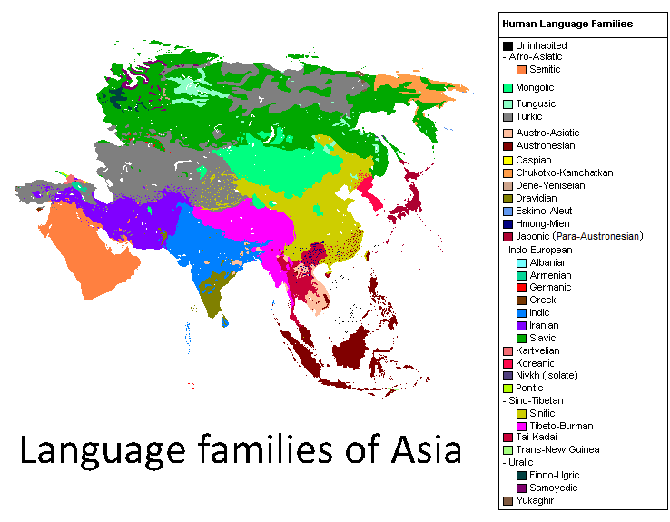
Introduction
Many language families and languages in the world, take Asia for example.
From wikipedia.org

Slide 4
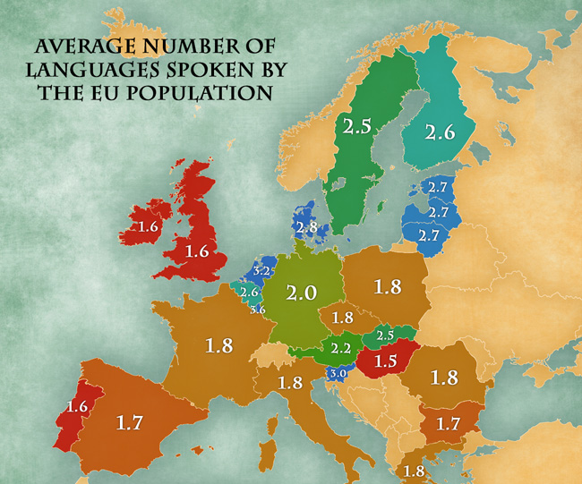
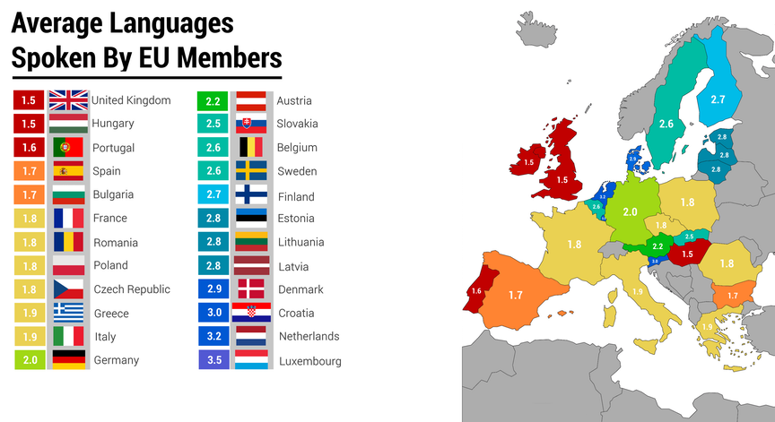
Introduction
Take EU for example, more than 2 languages are spoken in most areas.
From reddit.com
From jakubmarian.com

Slide 5
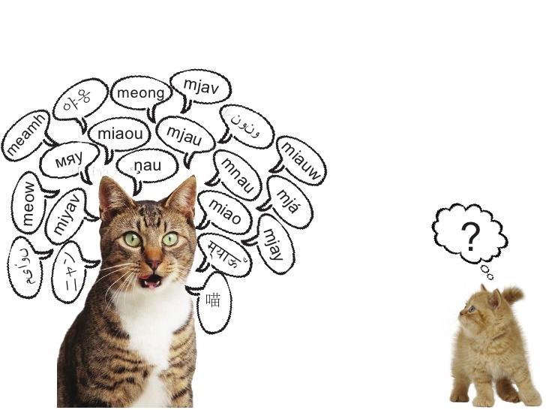
Introduction (Language identification)
ASR systems need to know which language they hear before they can work.

Slide 6
Introduction (LID based on i-vector)
Universal
background model
Language
labels
MFCC
features
Total variability
space
i-vector
extraction
Back-end models (LDA, PLDA, …)

Slide 7
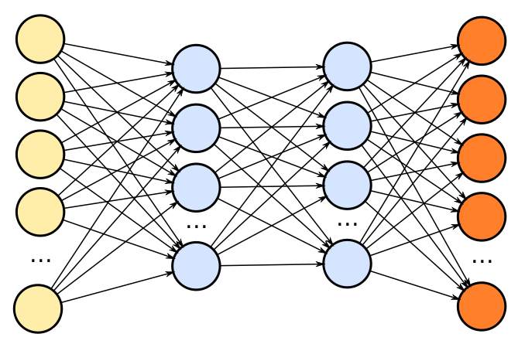
Introduction (LID based on DNN)
Fbank
features
Language
labels

Slide 8
Introduction (Acoustic features)
MFCC and Fbank features are both acoustic features.
Acoustic features involve no explicit phonetic information
which is important for LID system.
Could we design features involving much phonetic information?

Slide 9
Phonetic feature
Phonetic features
Phonetic
DNN
Fbank features
Phonetic DNN
the acoustic model of an ASR system.
Phonetic features
the output of last hidden layer in phonetic model.

Slide 10
Phonetic feature
Advantages of phonetic features for LID
languages are more discriminated by phonetic information than by acoustic information.
phonetic features represent information at a higher level,
thus more invariant with respect to noise and channels

Slide 11
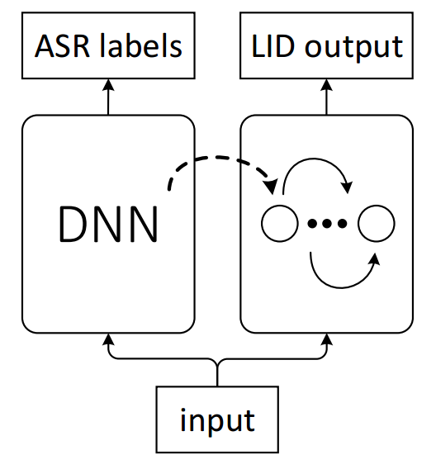
Phone-aware LID

Slide 12
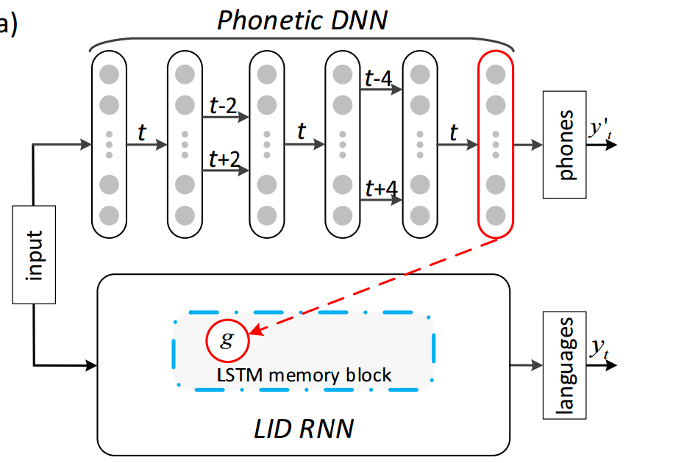
Phone-aware LID (system design)

Slide 13
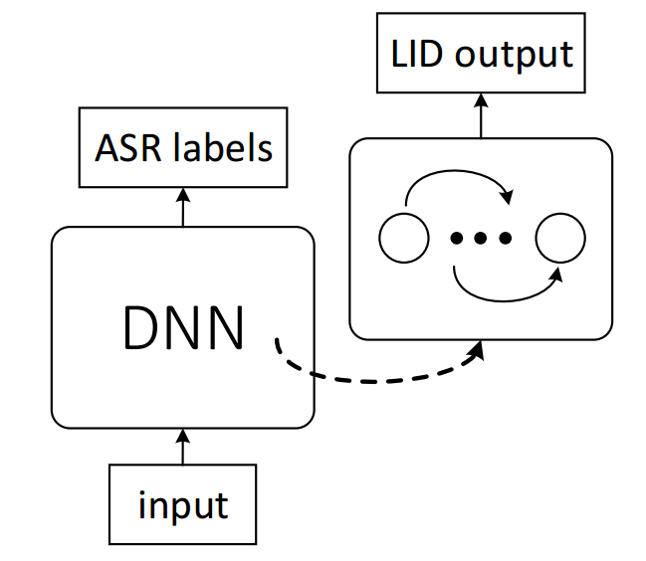
Phonetic temporal neural model (extended work)
Why not end-to-end?
Phonetic info and LID is highly correlated, and phonetic info is sufficient for LID
Phonetic DNNs borrow phonetic data, providing more detailed knowledge.
Phonetic Temporal Neural Model for Language Identification,
Zhiyuan Tang, Dong Wang, Yixiang Chen, Lantian Li and Andrew Abel,
IEEE/ACM Transactions on Audio, Speech, and Language Processing, 2017.

Slide 14
Phonetic temporal neural model (extended work)
PTN
Phonetic Temporal Neural Model for Language Identification,
Zhiyuan Tang, Dong Wang, Yixiang Chen, Lantian Li and Andrew Abel,
IEEE/ACM Transactions on Audio, Speech, and Language Processing, 2017.

Slide 15
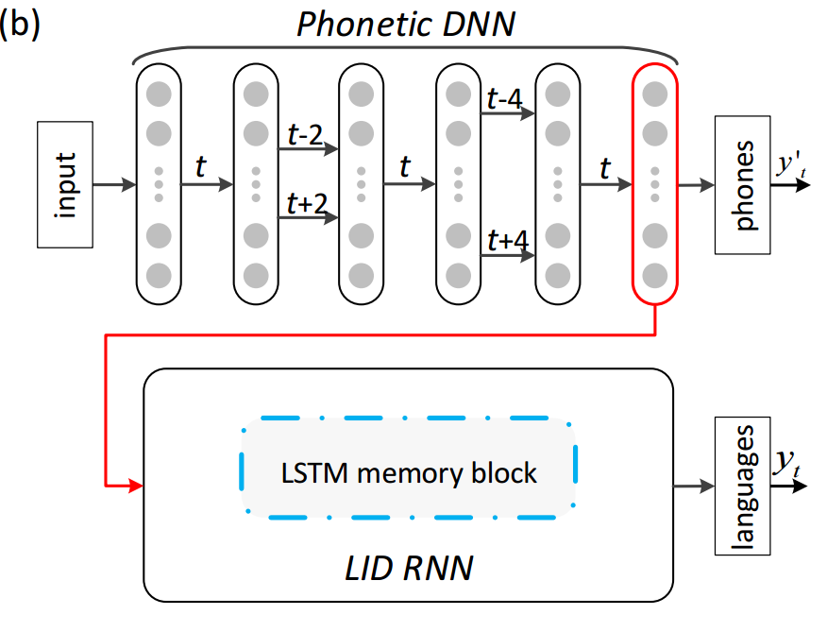
PTN (system design)

Slide 16
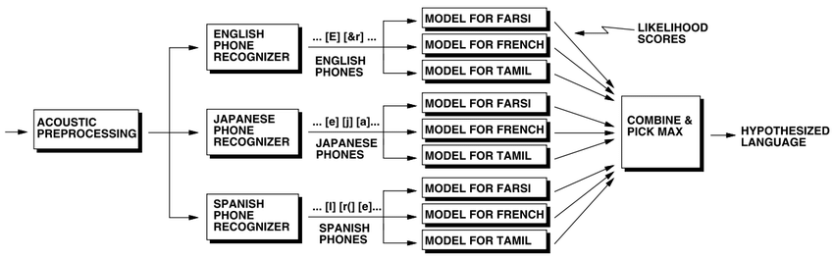
Reminiscence to PPRLM
Frame-level phone sequence model
Phone posterior sequence, more rich information
Better phone sequence and better LM.

Slide 17
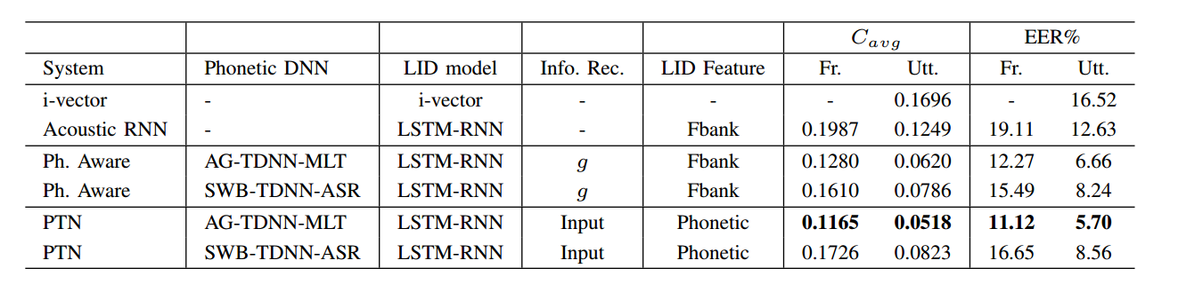
Experiments (on Babel database)
Babel contains seven languages:
Assamese, Bengali, Cantonese, Georgian, Pashto, Tagalog and Turkish.

Slide 18
Experiments (on Babel database)
Babel contains seven languages:
Assamese, Bengali, Cantonese, Georgian, Pashto, Tagalog and Turkish.

Slide 19
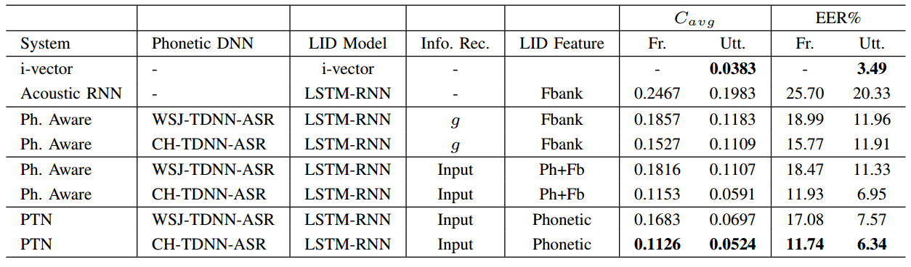
Experiments (on AP16-OLR database)
AP16-OLR contains seven languages:
Mandarin, Cantonese, Indonesian, Japanese, Russian, Korean and Vietnamese.
http://cslt.riit.tsinghua.edu.cn/mediawiki/index.php/OLR_Challenge_2016

Slide 20
Experiments (on AP16-OLR database)
AP16-OLR contains seven languages:
Mandarin, Cantonese, Indonesian, Japanese, Russian, Korean and Vietnamese.
http://cslt.riit.tsinghua.edu.cn/mediawiki/index.php/OLR_Challenge_2016

Slide 21
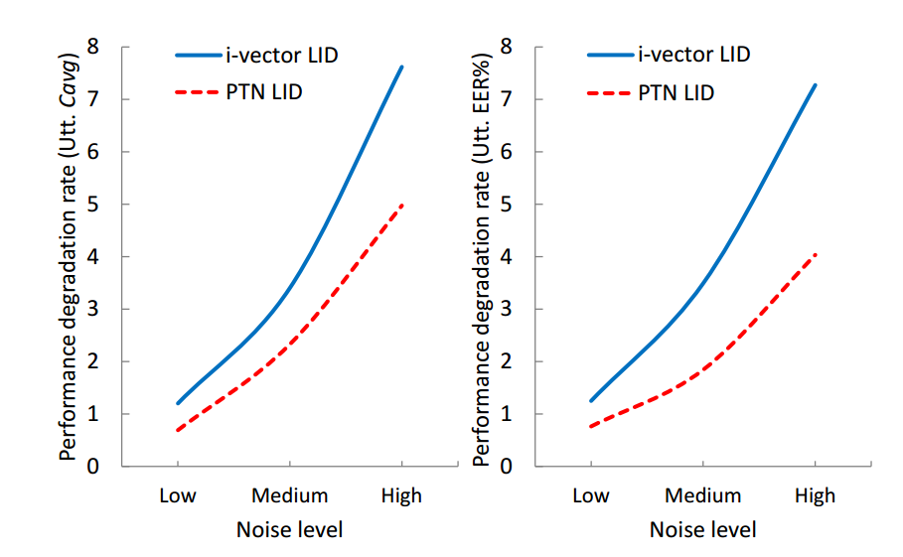
Experiments (Noise robustness of PTN)

Slide 22
Conclusions
Phonetic feature is more informative than raw acoustic feature for discriminating between languages.
Phone-aware and phonetic neural model (PTN) are proposed based on phonetic feature for LID.
PTN performs better than the phone-aware LID, even better than i-vector based system on short speech.
Future work will improve the performance of the neural LID approach on long sentences.

Slide 23

Thanks a lot.

