Slide 1
Bi-Monthly REPORT
Ziwei Bai

Slide 2
Overview
Patent
TTS
Chatting Model
ML BOOK － Kernel Method

Slide 3










Patent
明
月
$$y_{i−1}$$
$$y_{i}$$
$$s_{i−1}$$
$$s_{i}$$
…
…
文体规则
$$α_{i,1}$$
$$α_{i,6}$$
$$α_{i,2}$$
$$α_{i,3}$$
$$α_{i,4}$$
$$α_{i,5}$$
h1
h2
h3
h4
h5
h6
x1
x2
x3
x4
x5
x6
h1
h2
h3
h4
h5
h6
x1
x2
x3
x4
x5
x6
月
光
洒
在
床
前

Slide 4
TTS
DNN
Bottleneck
RNN

Slide 5



TTS－DNN
main task
secondary task
output
softmax
non linear
non linear
linear
$$x_{t−1}$$
$$x_{t}$$
$$x_{t+1}$$

Slide 6
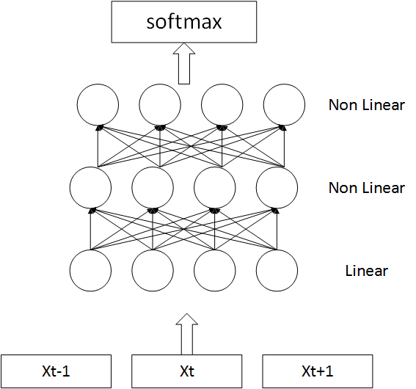
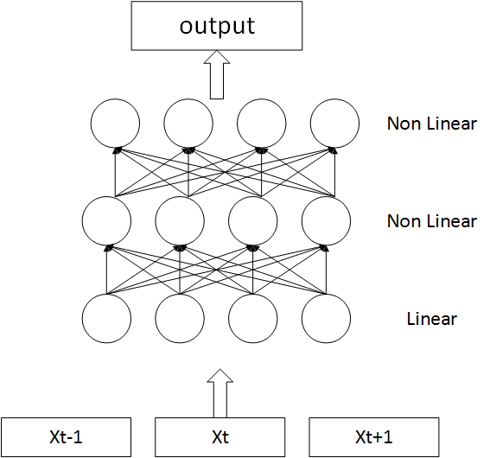
TTS-DNN

Slide 7
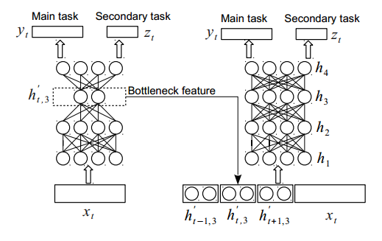
TTS-Bottleneck

Slide 8



TTS-RNN
lf0,mgc
silence
recurrent output
softmax
non linear
lstm
linear
$$x_{t−1}$$
$$x_{t}$$
$$x_{t+1}$$

Slide 9
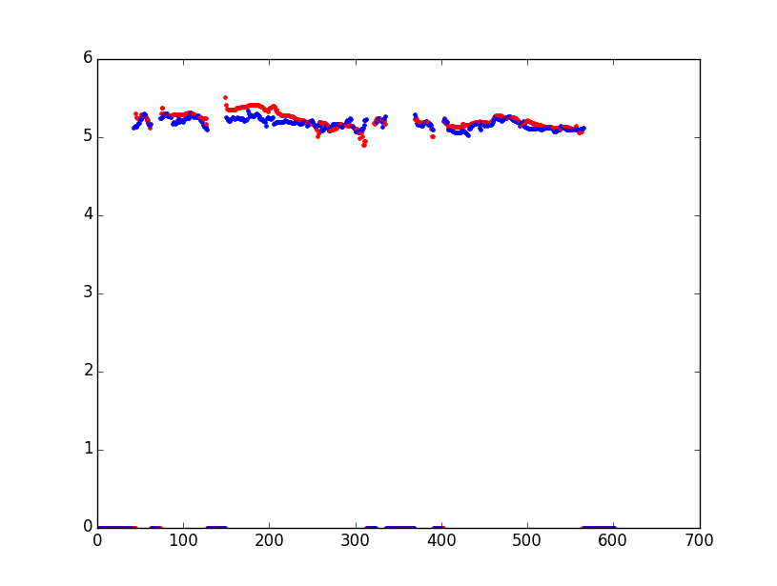
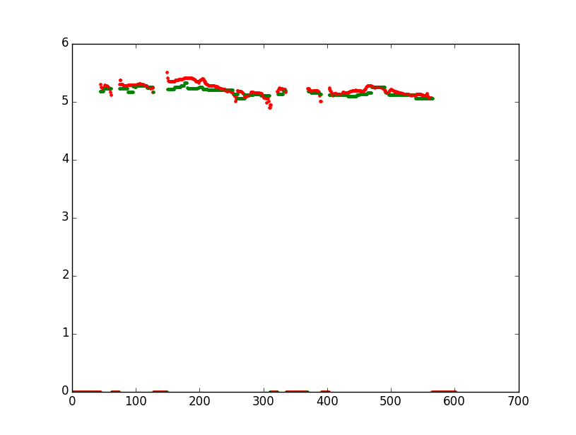
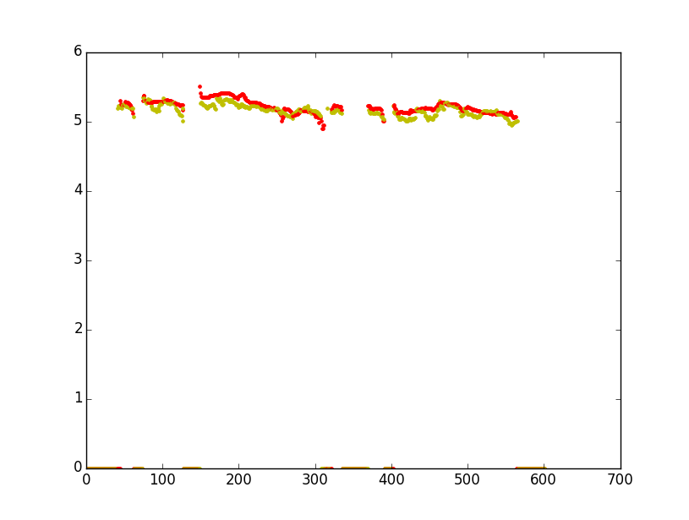
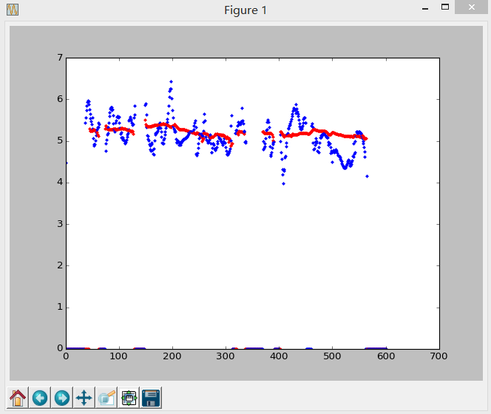
Result

Slide 10
Chatting Model
Accomplish Paper
Neural Responding Machine for Short-Text
Read Paper
Building End－To－End Dialogue System Using Generative Hierarchical Neural Network Models

Slide 11
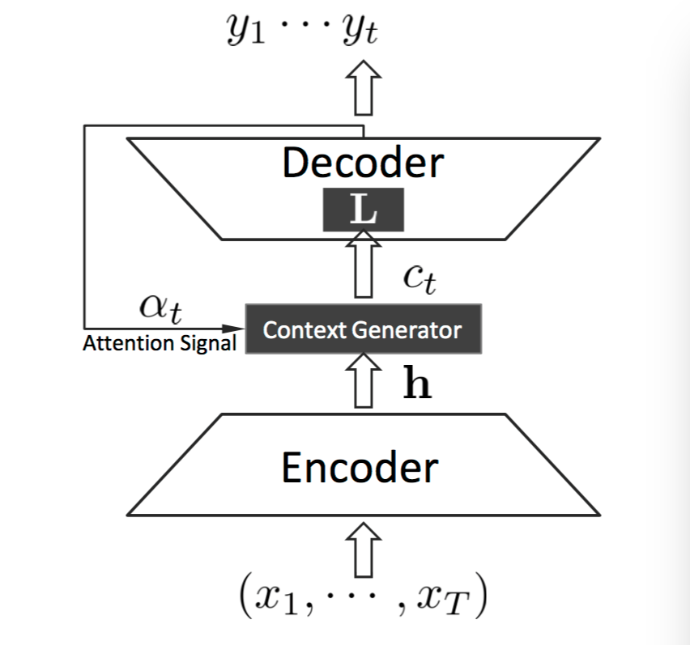
Accomplish Paper Encoder-Decoder

Slide 12
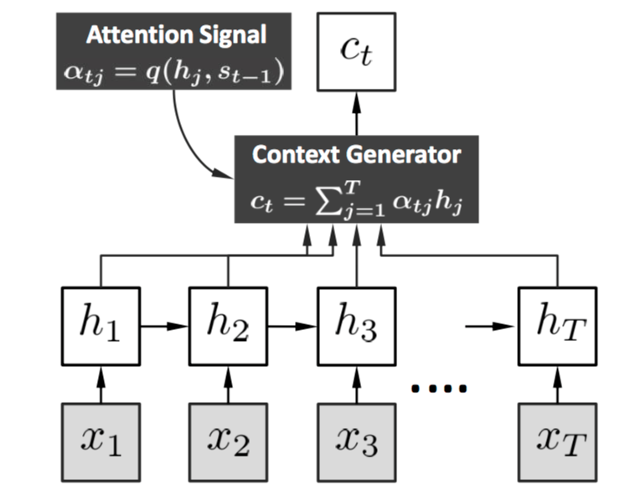
Accomplish Paper Local scheme

Slide 13
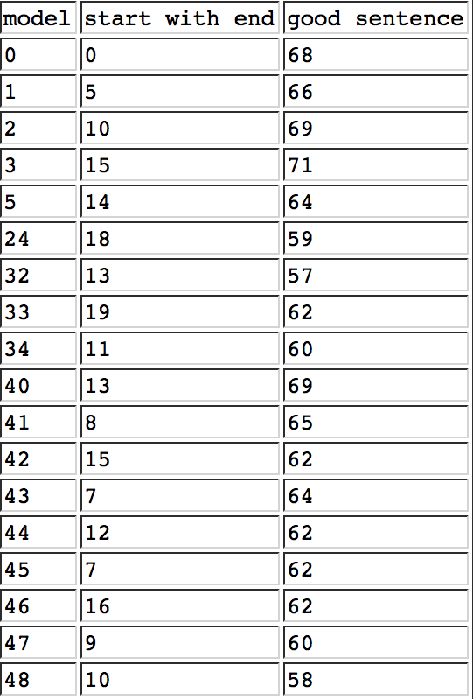
Accomplish Paper Result
http://cslt.riit.tsinghua.edu.cn/mediawiki/index.php?title=Schedule&action=edit&section=6

Slide 14
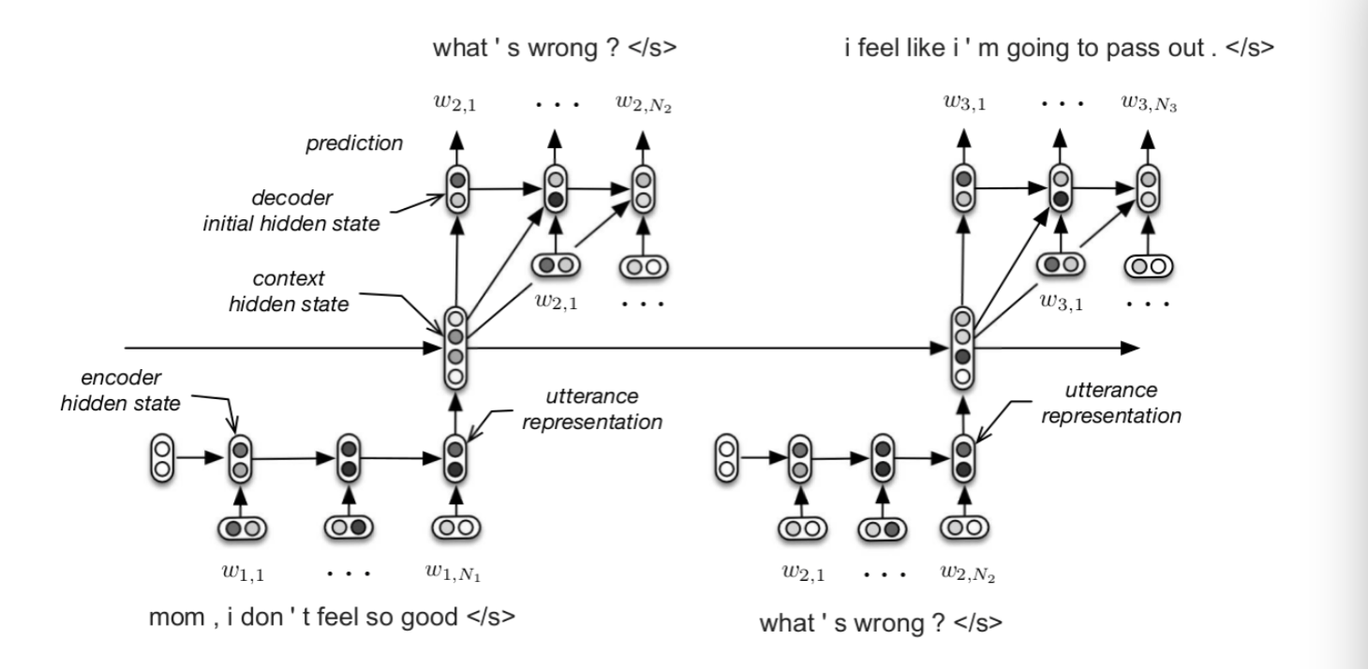
Read paper

Slide 15
Kernel Method
Linear regression & dual representation
Kernel function
The property & construction of kernel

Slide 16
Kernel Method
Nine pages
References
PRML
Kernel Methods for Pattern Analysis
统计学习方法

