Slide 1
Theano-Basic
CSLT, NLP

Slide 2
Theano-Basic
Theano is a Python library that lets you to define, optimize, and evaluate mathematical expressions, especially ones with multi-dimensional arrays (numpy.ndarray).
So, what could theano do?
1. Define a function, let theano compute gradient.
2. Fast compute multi-dimensional arrays.
3. Use GPU in theano.
4. Define your own operator & gradient.

Slide 3
Theano-Basic
Why theano so fast?
Theano will first compile theano function to c-code, and when you run theano program, you are almost running c program.

Slide 4
Theano-Basic
Data type:
scalar → single variable .
vector → 1-dimension variable.
row → 2-dimension variable but column fixed to 1.
col → 2-dimension variable but row fixed to 1.
matrix → 2-dimension variable.
tensor3 → 3-dimension variable.
tensor4 → 4-dimension variable.
byte: bscalar, bvector, bmatrix, brow, bcol, btensor3, btensor4
16-bit integers: wscalar, wvector, wmatrix, wrow, wcol, wtensor3,wtensor4
32-bit integers: iscalar, ivector, imatrix, irow, icol, itensor3,itensor4
64-bit integers: lscalar, lvector, lmatrix, lrow, lcol, ltensor3, ltensor4
float: fscalar, fvector, fmatrix, frow, fcol, ftensor3, ftensor4
double: dscalar, dvector, dmatrix, drow, dcol, dtensor3, dtensor4
complex: cscalar, cvector, cmatrix, crow, ccol, ctensor3, ctensor4

Slide 5
Theano-Basic
Condition
T.switch( cond, ift, iff )
Theano variable could not directly use symbol comparison.
cond params can receive parameters →
theano.tensor.lt(a, b)
Returns a symbolic 'int8' tensor representing the result of logical less-than (a<b). Also available using syntax a < b
theano.tensor.gt(a, b)
Returns a symbolic 'int8' tensor representing the result of logical greater-than (a>b). Also available using syntax a > b
theano.tensor.le(a, b)
Returns a variable representing the result of logical less than or equal (a<=b). Also available using syntax a <= b
theano.tensor.ge(a, b)
Returns a variable representing the result of logical greater or equal than (a>=b). Also available using syntax a >= b
theano.tensor.eq(a, b)
Returns a variable representing the result of logical equality (a==b).
theano.tensor.neq(a, b)
Returns a variable representing the result of logical inequality (a!=b).

Slide 6
Theano-Basic
Loop
theano.scan(fn, sequences=None, outputs_info=None, non_sequences=None, n_steps=None, truncate_gradient=-1, go_backwards=False, mode=None, name=None, profile=False, allow_gc=None, strict=False)
fn : fn is a function that describes the operations involved in one step of scan.
sequences : sequences is the list of Theano variables or dictionaries describing the sequences scan has to iterate over.
outputs_info : outputs_info is the list of Theano variables or dictionaries describing the initial state of the outputs computed recurrently
non_sequences : non_sequences is the list of arguments that are passed to fn at each steps.
n_steps : n_steps is the number of steps to iterate given as an int or Theano scalar.

Slide 7
Theano-Basic
Scan Example: Computing tanh(x(t).dot(W) + b)
import theano
import theano.tensor as T
import numpy as np
X = T.matrix("X")
W = T.matrix("W")
b_sym = T.vector("b_sym")
results, updates = theano.scan(lambda v: T.tanh(T.dot(v, W) + b_sym), sequences=X)
compute_elementwise = theano.function(inputs=[X, W, b_sym], outputs=[results])
# test values
x = np.eye(2, dtype=theano.config.floatX)
w = np.ones(
(2, 2), dtype=theano.config.floatX)
b = np.ones((2), dtype=theano.config.floatX)
b[1] = 2
print compute_elementwise(x, w, b)[0]
# comparison with numpy
print np.tanh(x.dot(w) + b)

Slide 8
Theano-Basic
Scan Example: Computing norms of lines of X
import theano
import theano.tensor as T
import numpy as np
# define tensor variable
X = T.matrix("X")
results, updates = theano.scan(
lambda x_i: T.sqrt((x_i ** 2).sum()),
sequences=[X])
compute_norm_lines =
theano.function(inputs=[X], outputs=[results])
# test value
x = np.diag(np.arange(1, 6, dtype=theano.config.floatX), 1)
print compute_norm_lines(x)[0]
# comparison with numpy
print np.sqrt((x ** 2).sum(1))

Slide 9
Theano-Basic
Scan Example: Computing the sequence x(t) = x(t - 2).dot(U) + x(t - 1).dot(V) + tanh(x(t - 1).dot(W) + b)
import theano
import theano.tensor as T
import numpy as np
# define tensor variables
X = T.matrix("X"); W = T.matrix("W");
b_sym = T.vector("b_sym");U = T.matrix("U");
V = T.matrix("V") ; n_sym = T.iscalar("n_sym")
results, updates = theano.scan(
lambda x_tm2, x_tm1: T.dot(x_tm2, U) +
T.dot(x_tm1, V) + T.tanh(n_steps=n_sym,
outputs_info=[dict(initial=X, taps=[-2, -1])])
compute_seq2 = theano.function(
inputs=[X, U, V, W, b_sym, n_sym],
outputs=[results])
# test values
x = np.zeros((2, 2), dtype=theano.config.floatX) # the initial value must be able to return x[1, 1] = 1
w = 0.5 * np.ones((2, 2), dtype=theano.config.floatX)
u = 0.5 * (np.ones((2, 2), dtype=theano.config.floatX) - np.eye(2, dtype=theano.config.floatX))
v = 0.5 * np.ones((2, 2), dtype=theano.config.floatX)
n = 10
b = np.ones((2), dtype=theano.config.floatX)
print compute_seq2(x, u, v, w, b, n)
# comparison with numpy
x_res = np.zeros((10, 2))
x_res[0] = x[0].dot(u) + x[1].dot(v) + np.tanh(x[1].dot(w) + b)
x_res[1] = x[1].dot(u) + x_res[0].dot(v) + np.tanh(x_res[0].dot(w) + b)
x_res[2] = x_res[0].dot(u) + x_res[1].dot(v) + np.tanh(x_res[1].dot(w) + b)
for i in range(2, 10):
x_res[i] = (x_res[i - 2].dot(u) + x_res[i - 1].dot(v) +
np.tanh(x_res[i - 1].dot(w) + b))
print x_res

Slide 10
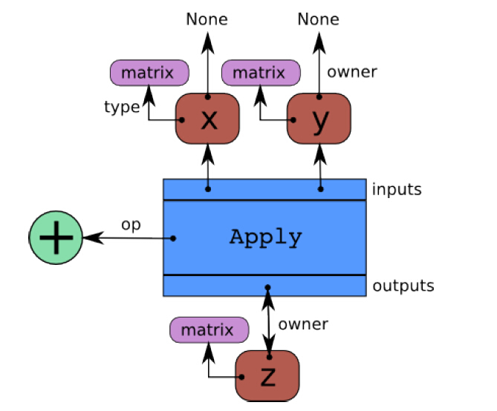
Theano-Basic
Theano is a graph model.
Theano builds internally a graph structure composed of interconnected variable nodes, op nodes and apply nodes.
In code :
x = T.dmatrix(’x’)
y = T.dmatrix(’y’)
z = x + y

Slide 11
Theano-Basic
Given two variable, compute their sum.
In python:
a =
b =
c = a + b
In numpy:
a = numpy.array()
b = numpy.array()
c = a + b
In theano:
ta = theano.shared(a)
tb = theano.shared(b)
tc = ta + tb

Slide 12
Theano-Basic
In theano:
Two steps:
First, compile a function
Import theano.tensor as T
a = T.scalar(‘a’)
b = T.scalar(‘b’)
c = a + b
f_sum = theano.function( inputs = [a, b]
outputs = c
)
Second, generate variable, and use the function.
test_a = theano.shared(10)
test_b = theano.shared(5)
test_c = f_sum(test_a, test_b)

Slide 13
Theano-Basic
Another example.
Using theano function:
First declare variable.
Second build symbolic expression.
Third compile function.
Forth use function.
Note:
In theano function, we could only use theano variable.
import theano
a = theano.tensor.vector()
out = a + a ** 10
f = theano.function([a], out)
print f([0, 1, 2])
‘array([0, 2, 1026])‘

Slide 14
Theano-Basic
How to use default variable in python?
def test_function(a, b = 5):
return a + b
print test_function(3) # will print 8
print test_function(3,3) # will print 6
How to use default variable in theano?
from theano import Param
x, y = T.dscalars(‘x’, ‘y’)
z = x + y
f = theano.function( inputs = [x, Param(y, default = 5)], outputs = z )

Slide 15
Theano-Basic
Automatic compute given function’s gradient is mostly why we choose theano.
How can theano do such job?
Chain Rule.
Define Two rules for gradient:
first is ROP for right operator gradient.
Second is LOP for left operator gradient.

Slide 16
Theano-Basic
theano.gradient.grad(cost,
wrt,
consider_constant=None,
disconnected_inputs='raise',
add_names=True,
known_grads=None,
return_disconnected='zero')
Return symbolic gradients for one or more variables with respect to some cost.
Parameters:
cost (Scalar (0-dimensional) tensor variable. May optionally be None if known_grads is provided.) – a scalar with respect to which we are differentiating
wrt (Tensor variable or list of variables.) – term[s] for which we want gradients
consider_constant (list of variables) – a list of expressions not to backpropagate through
Return type:
variable or list/tuple of Variables (matching wrt)

Slide 17
Theano-Basic
Recommend some books:
theano Documentation Release 0.7
Deep Learning Tutorial Release 0.1

